Slide 1
Assignment 1 – Active Filter

Slide 2
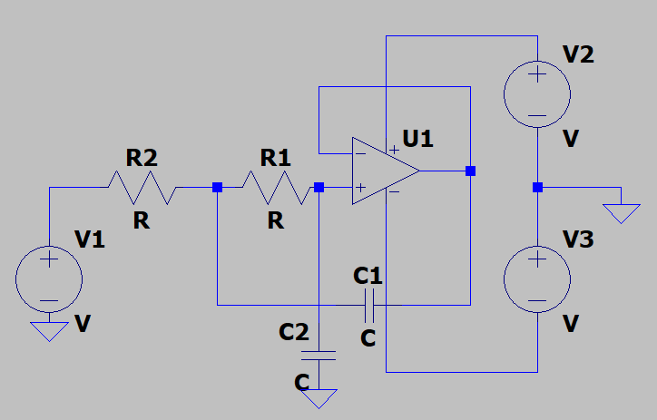
Components
Universalopamp - 1
Resistors – 2
Capacitors – 2
Voltage source - 3

Slide 3
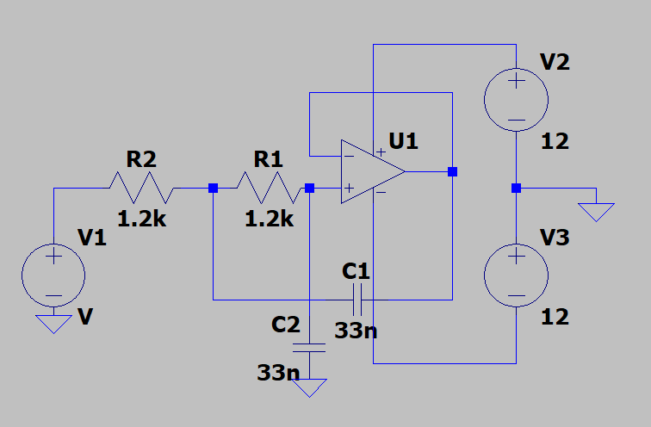
R1 = 1.2k
R2 = 1.2k
C1 = 33n
C2 = 33n
V2 = 12 V
V3 = 12 V
V1 – Variable frequency source

Slide 4
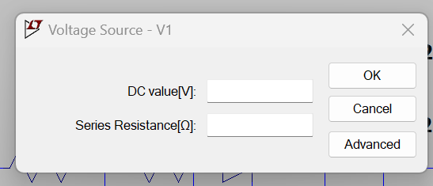
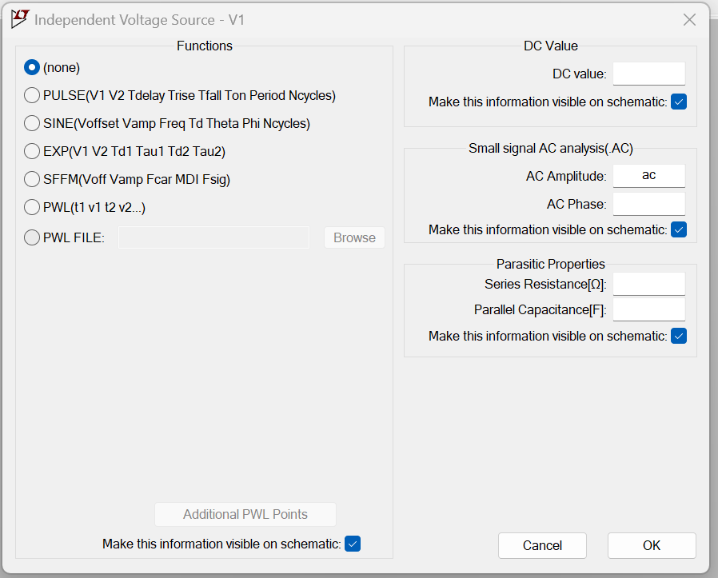

Slide 5
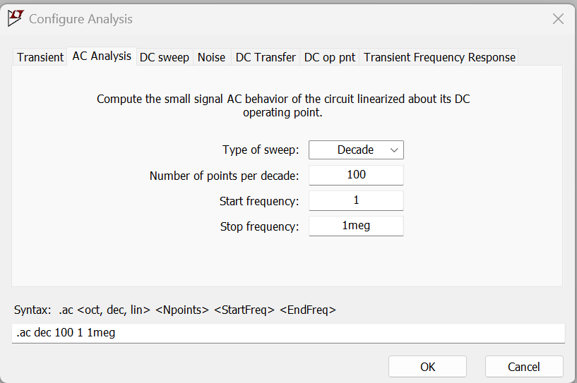
AC analysis for frequency characteristics
Run simulation
Filter type – LPF , HPF, BPF, .. ?
Change number of points per decade to 1.

Slide 6
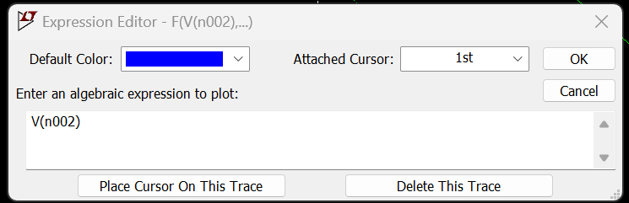
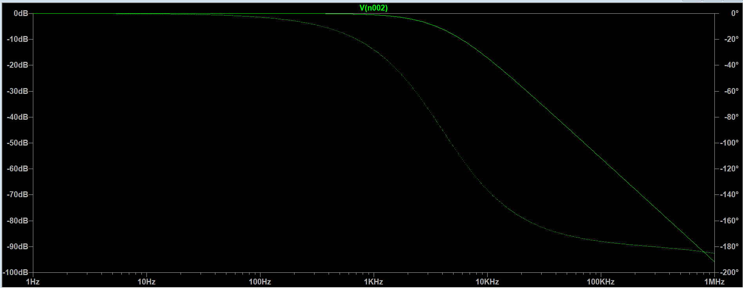

Slide 7
Assignment 2 – Transient analysis of LPF

Slide 8
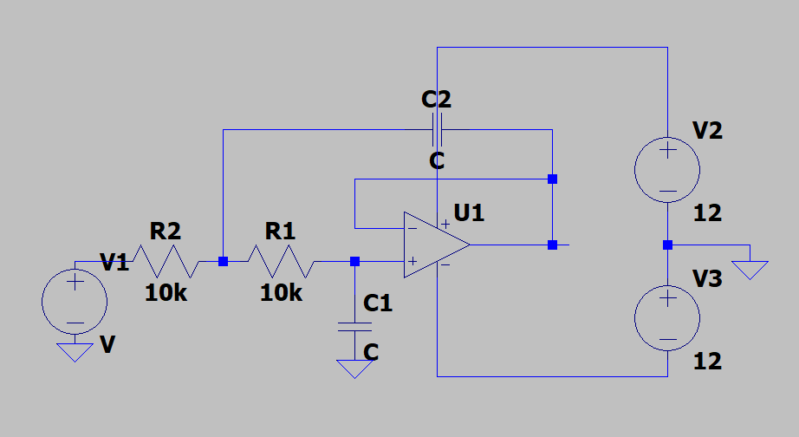
For the above circuit the double pole lies at f = 16 kHz.
Find capacitance C?
Show the time domain output of the circuit for a sinusoidal input source V1 by varying the frequency f of sinusoid as follows f = [1kHz 10kHz 1000kHz 1MHz].

Slide 9
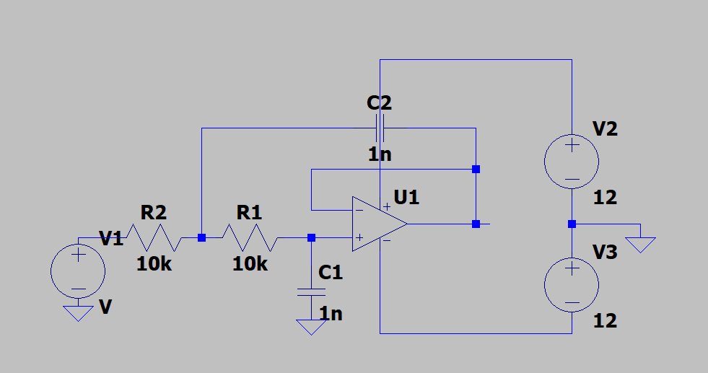
C = 1nF
Components
Universalopamp - 1
Resistors – 2
Capacitors – 2

Slide 10
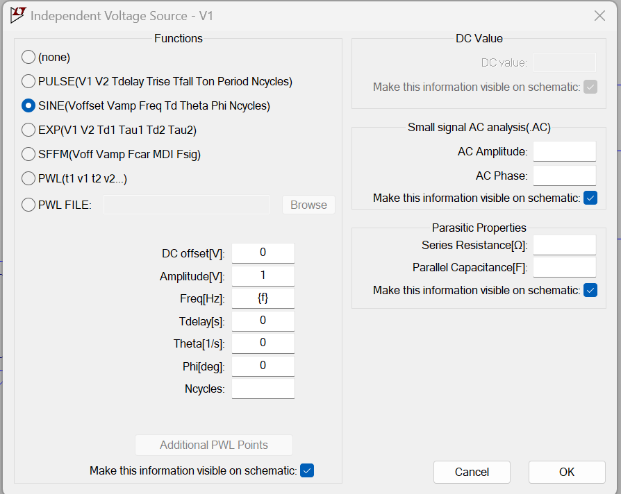
2 Ways to simulate
Manually enter each value and then simulate the circuit
Use the .step command to sweep across a range of values in a single simulation run
{f} – f is a parameter

Slide 11
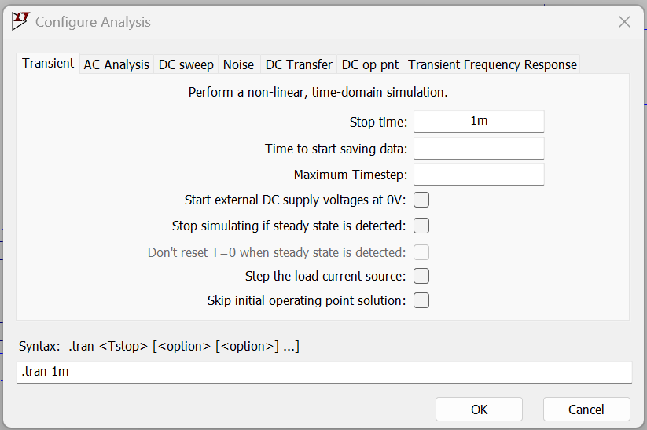

Slide 12
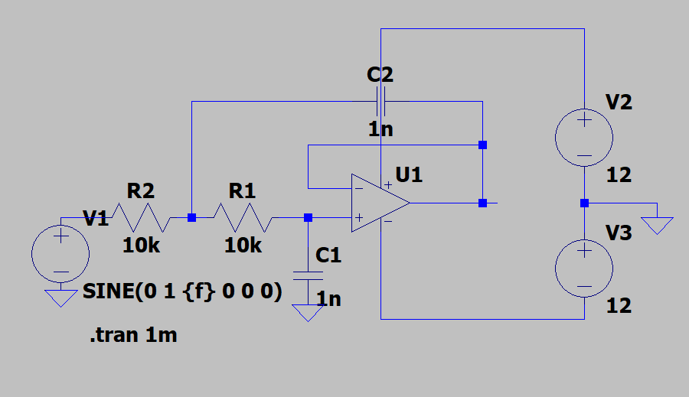

Slide 13
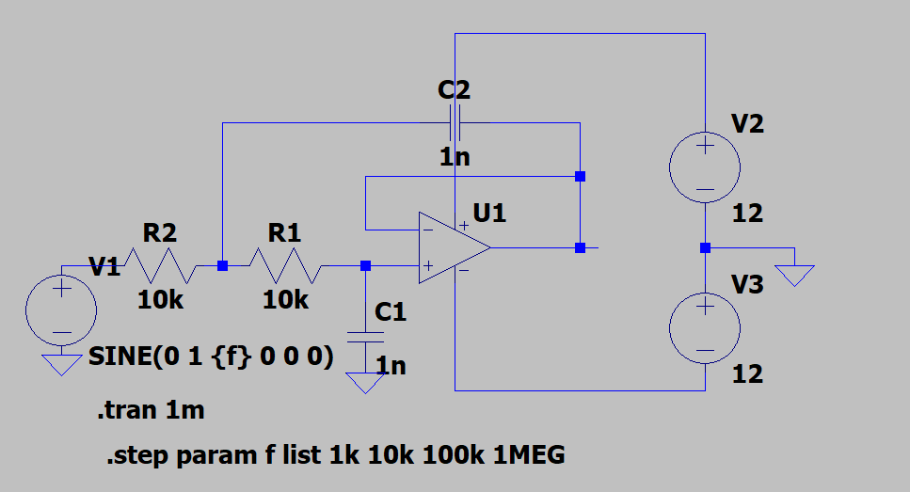
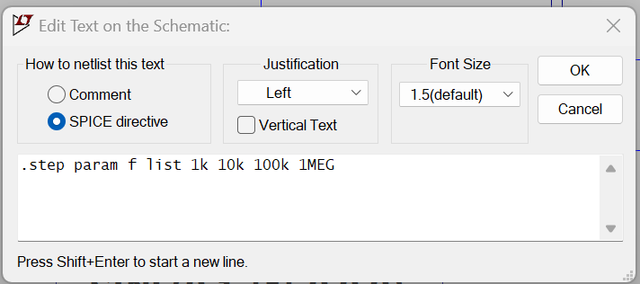
.step param f list 1k 10k 100k 1MEG

Slide 14
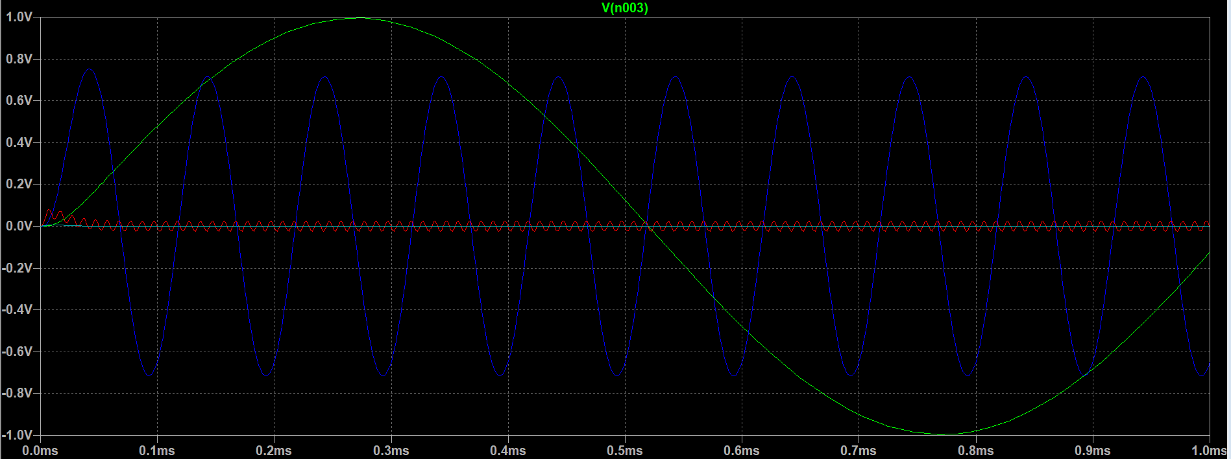

Slide 15
Assignment 3 – NOT gate using CMOS

Slide 16
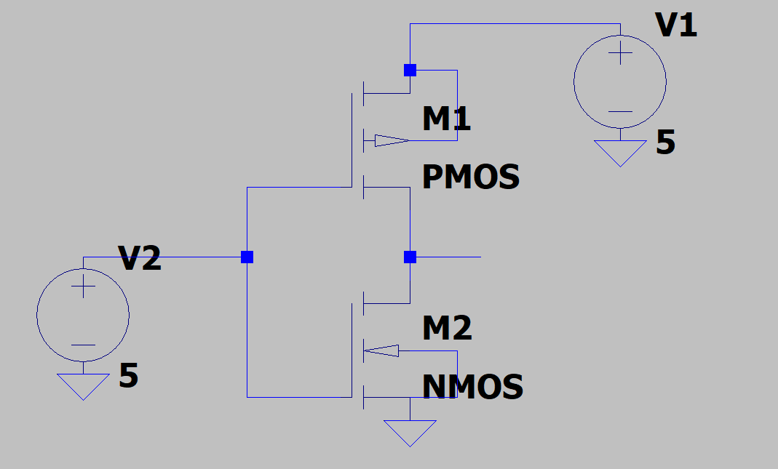
Components
pmos4 - 1
nmos4 – 1

Slide 17
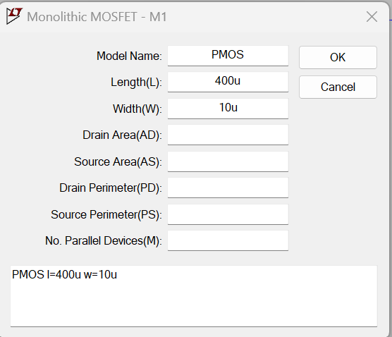
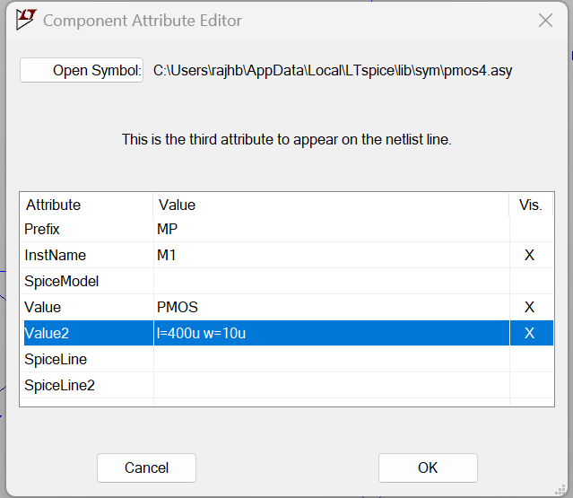
Ctrl + right click

Slide 18
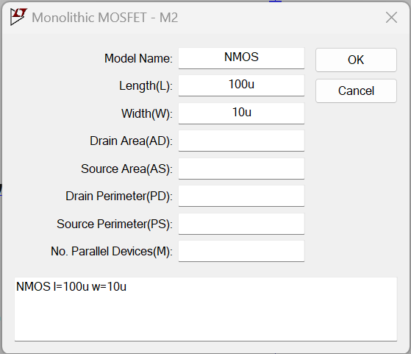
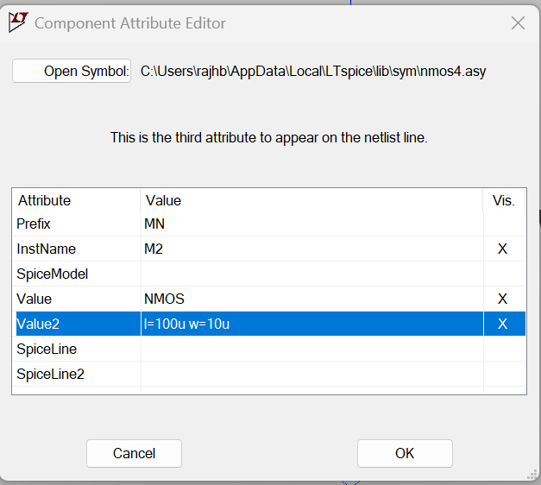

Slide 19
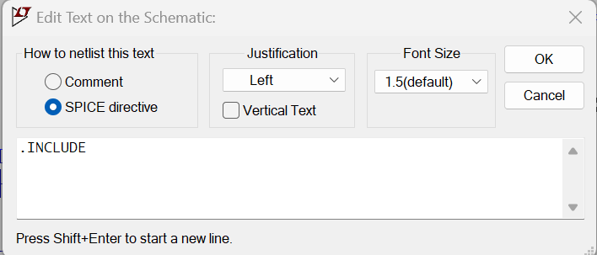
Including the model
Right click over .INCLUDE
Browse

Slide 20
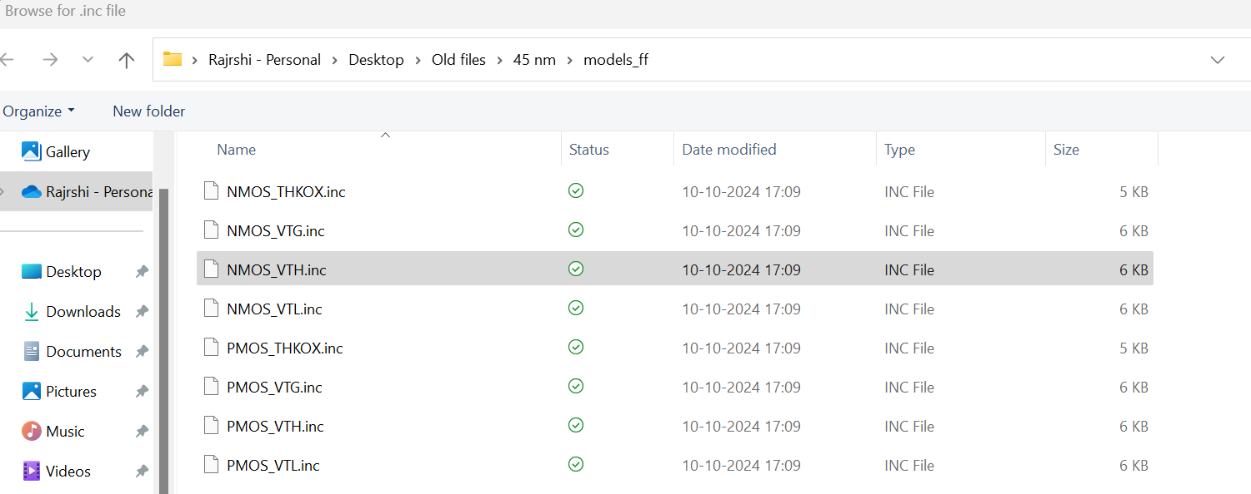

Slide 21
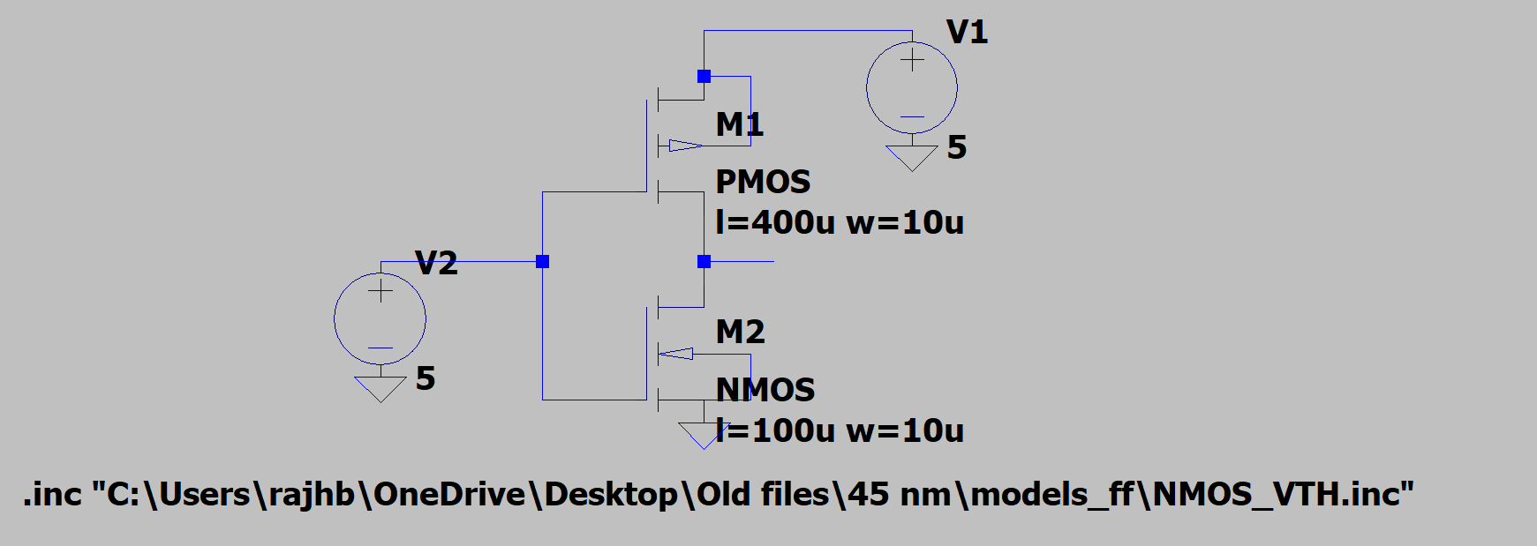

Slide 22
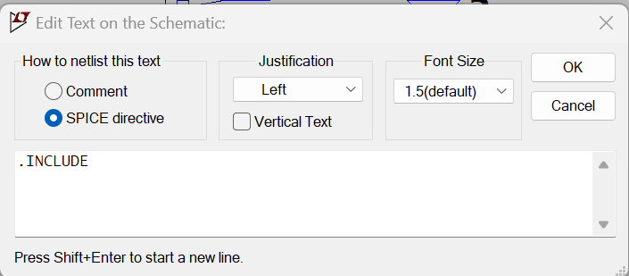
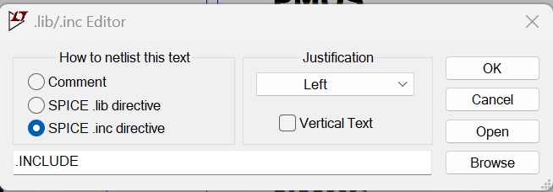
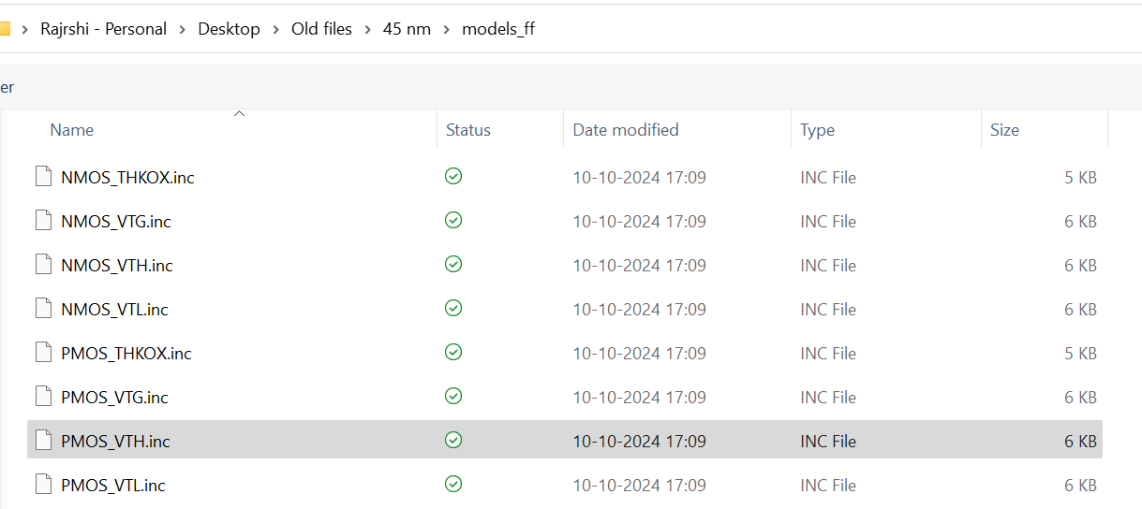

Slide 23
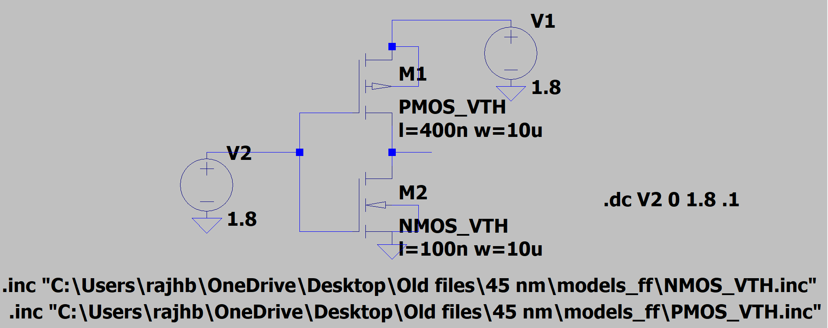
Change L = 400n for PMOS
Change L = 100n for NMOS
Change name of PMOS to PMOS_VTH
Change name of NMOS to NMOS_VTH

Slide 24
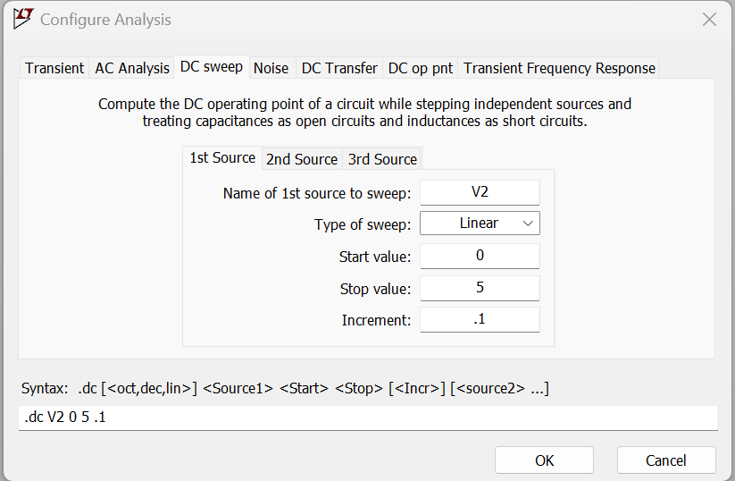
DC sweep analysis sweeps the DC voltage of the input signal

Slide 25
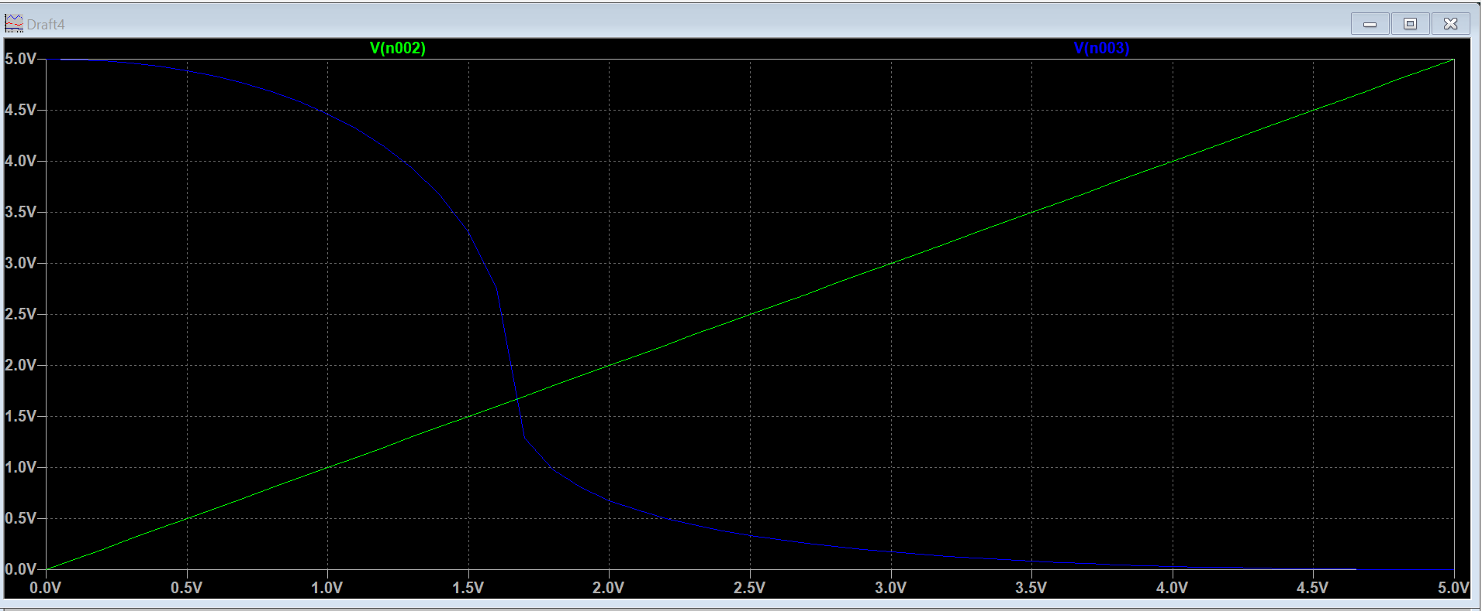

Slide 26
Assignment 4 – NOR gate using CMOS

Slide 27
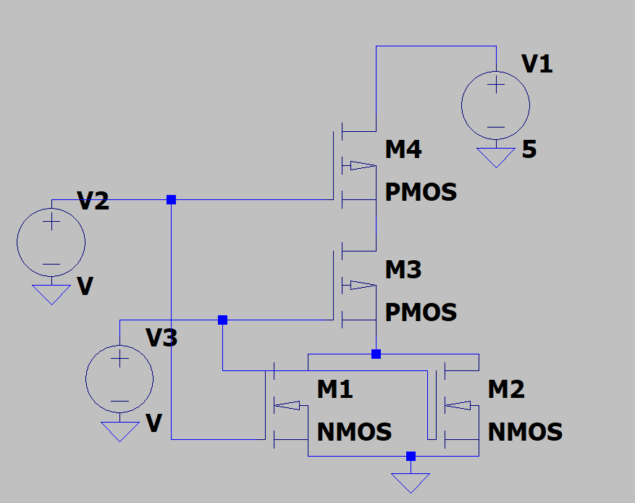
Components
pmos - 2
nmos – 2

Slide 28
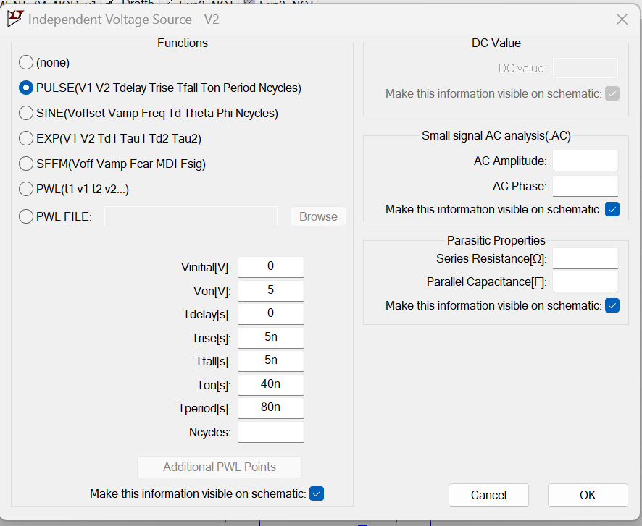
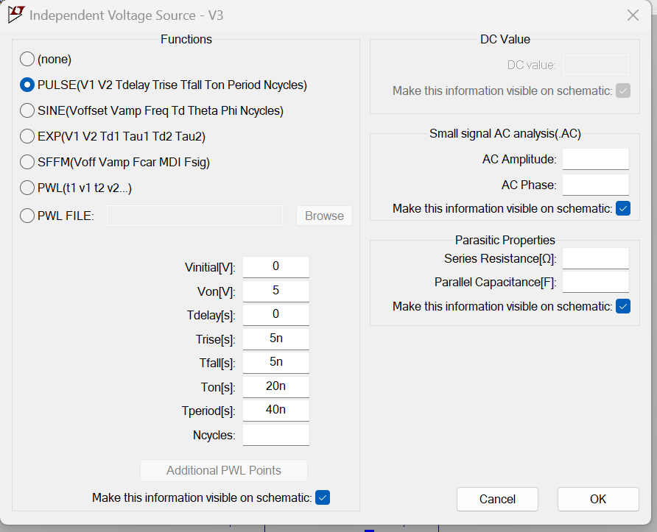

Slide 29
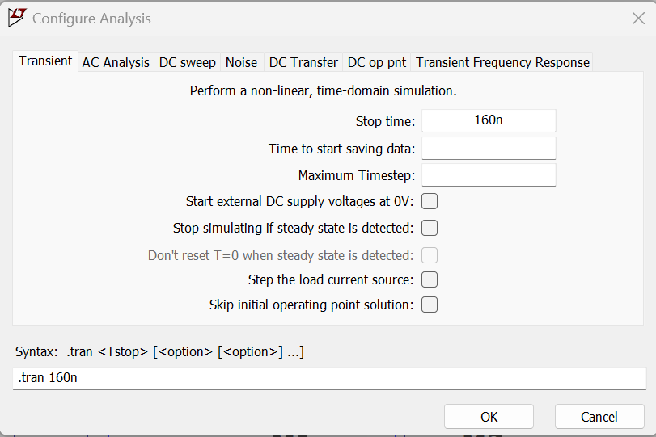

Slide 30
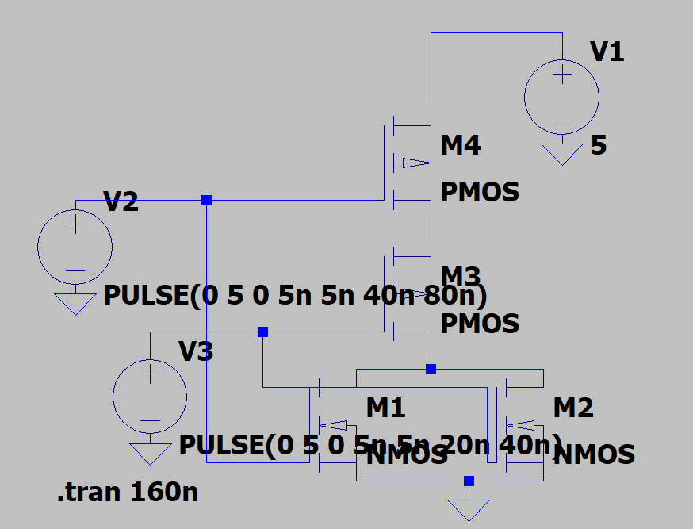

Slide 31
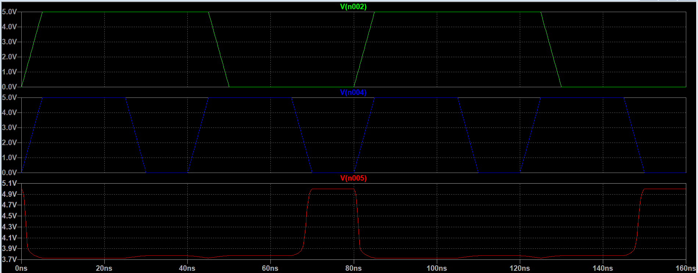

Slide 32
Assignment 5 – Current Mirror

Slide 33
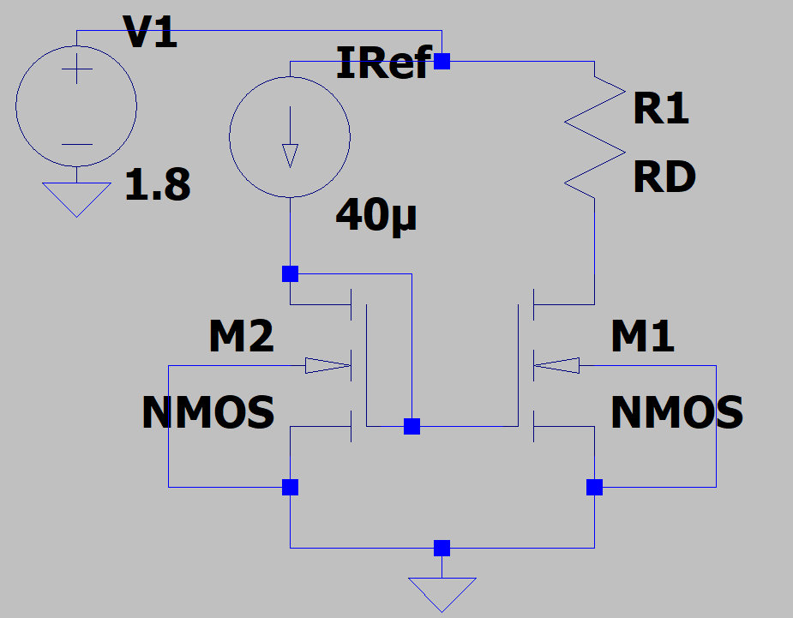

Components
Current source - 1
nmos4 – 2
Resister – 1
For 45nm technology max source voltage = 1.8 V.
$$I_{2}$$

Slide 34
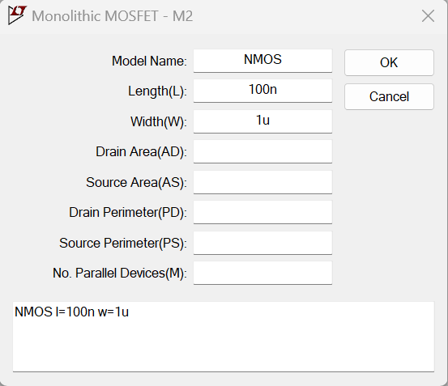
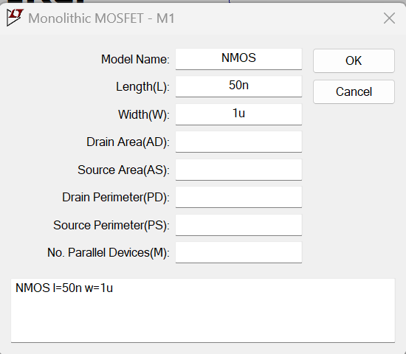
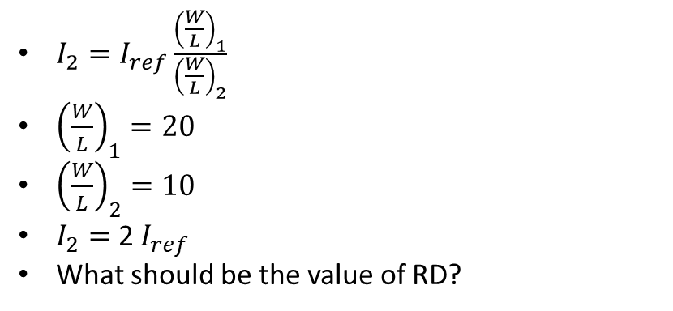
$I_{2}=I_{ref}\frac{{\left(\frac{W}{L}\right)}_{1}}{{\left(\frac{W}{L}\right)}_{2}}$
${\left(\frac{W}{L}\right)}_{1}=20$
${\left(\frac{W}{L}\right)}_{2}=10$
$I_{2}=$ 2 $I_{ref}$
What should be the value of RD?

Slide 35
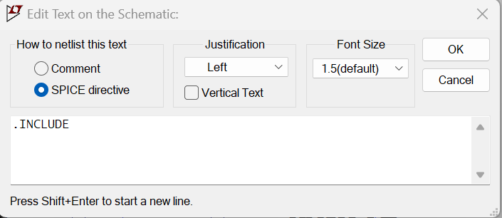
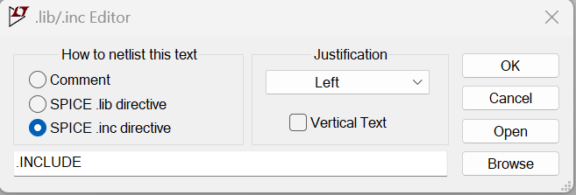
Including the model
Right click .INCLUDE
Click Browse
Goto .\45 nm\models_ff
Choose NMOS_VTH.inc

Slide 36
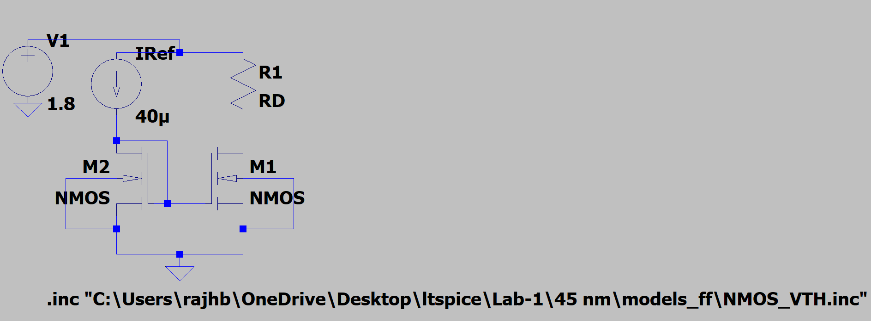

Slide 37
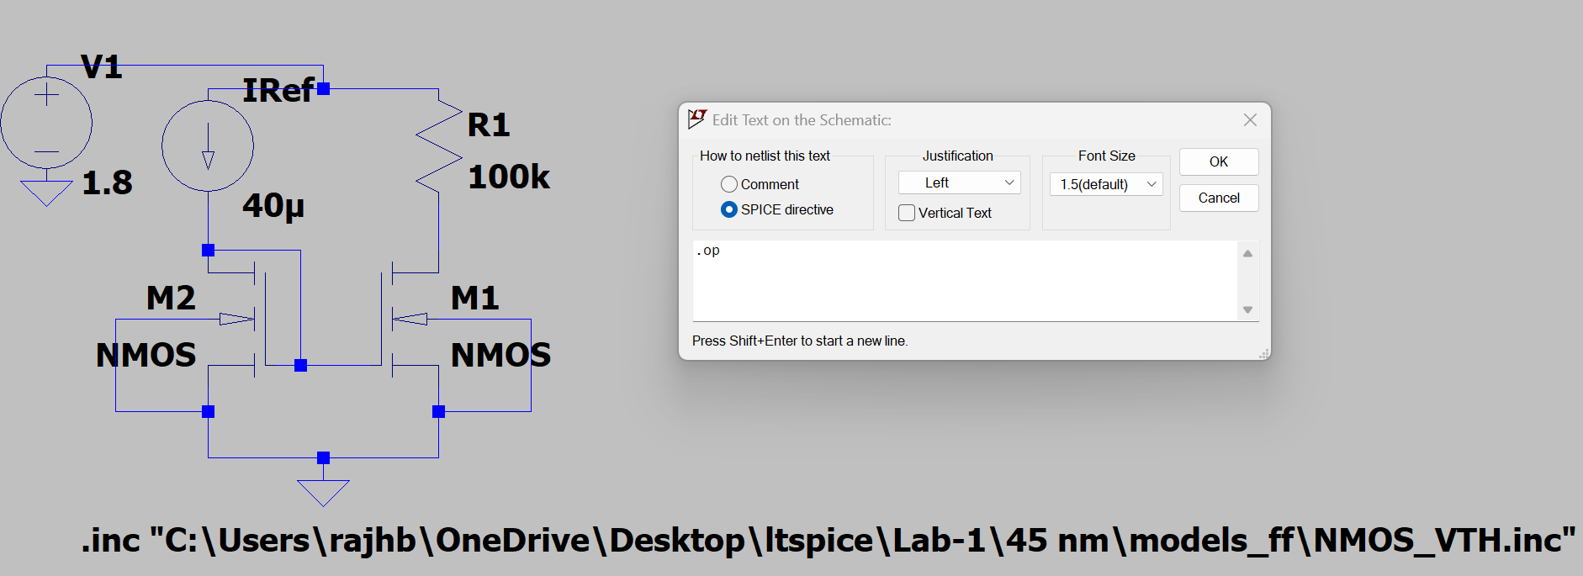
Now we check the operating point (DC biasing)
Let RD = 100k

Slide 38
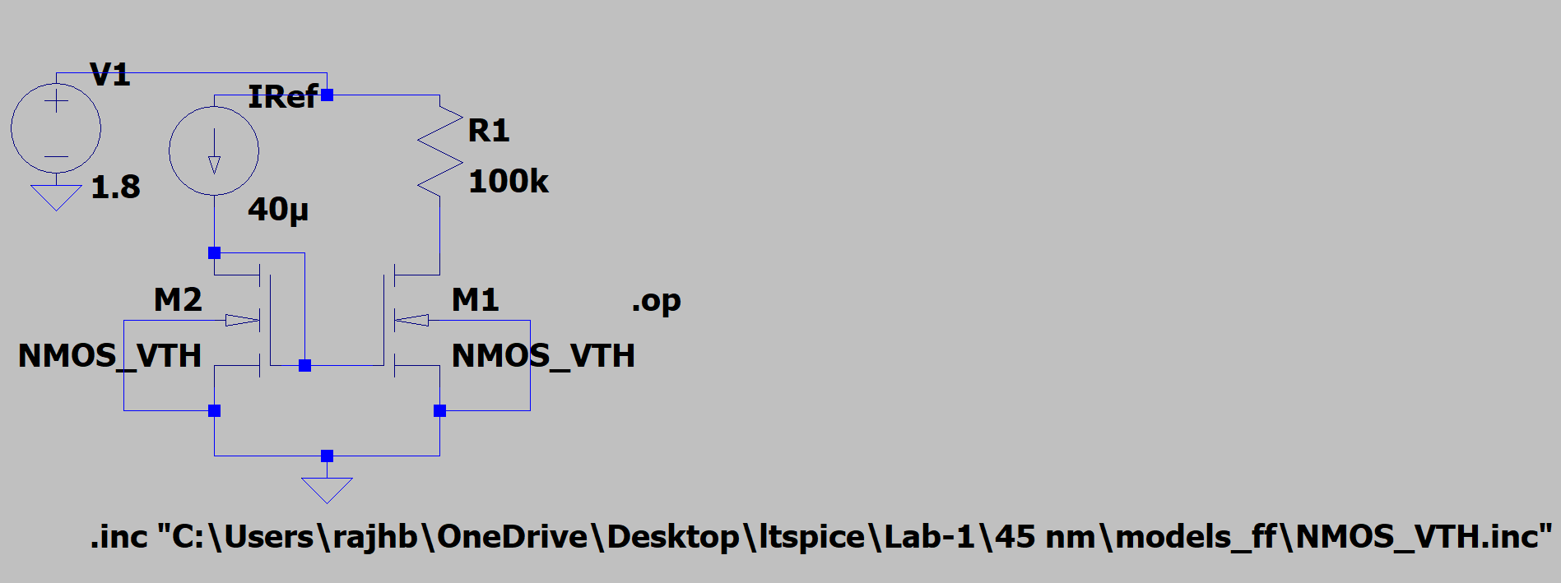
Change names of NMOS to NMOS_VTH

Slide 39
Run simulation
View-> Spice output log
Current in M1 is less.
RD needs to be changed.

Slide 40

Use RD = 20 k

Slide 41
Assignment 6 – CS amplifier small signal model
Live demonstration

